Slide 1
Lecture 3
Introduction to OOP in python

Slide 2
Plan
Functions
Lambda functions
Classes and objects
Inheritance

Slide 3
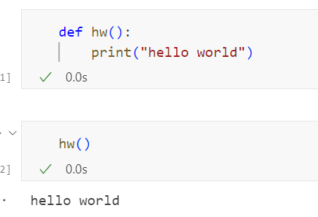
Functions
In python a function is defined using “def” keyword

Slide 4
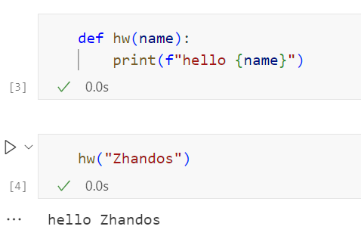
Functions
Arguments are used to pass values to the function
Arguments are denoted in the brackets in the definition and calling of the function

Slide 5
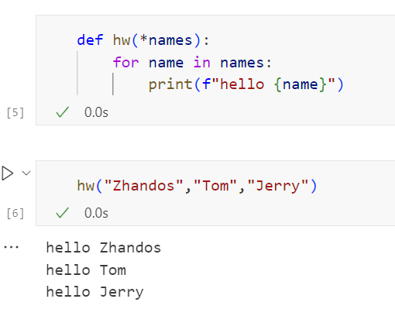
Functions
If you do not know how many arguments that will be passed into your function, add a * before the parameter name in the function definition.
This way the function will receive a tuple of arguments, and can access the items accordingly

Slide 6
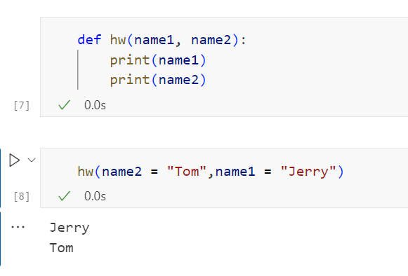
Functions
You can also send arguments with the key = value syntax.
This way the order of the arguments does not matter.

Slide 7
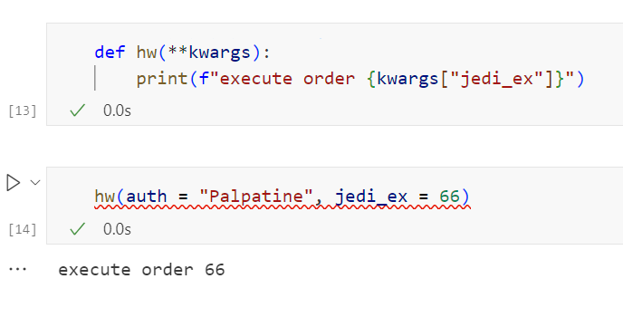
Functions
If you do not know how many keyword arguments that will be passed into your function, add two asterisk: ** before the parameter name in the function definition.
This way the function will receive a dictionary of arguments, and can access the items accordingly

Slide 8
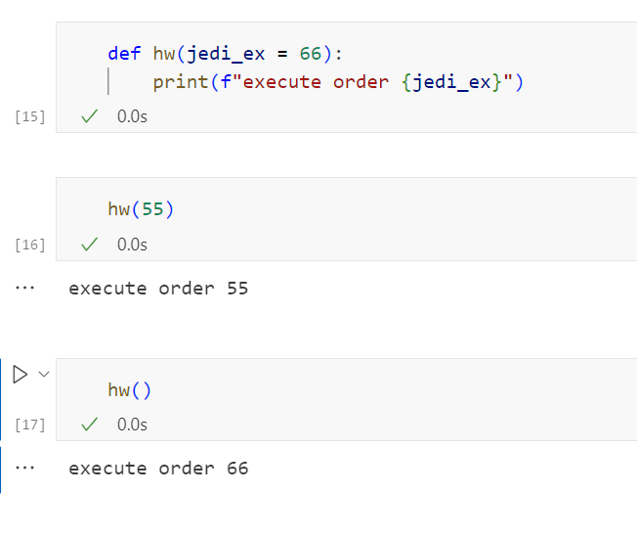
Functions
The following example shows how to use a default parameter value
If we call the function without argument, it uses the default value

Slide 9
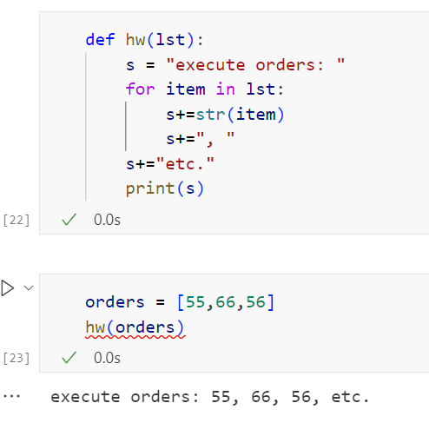
Functions
You can pass lists into a function

Slide 10
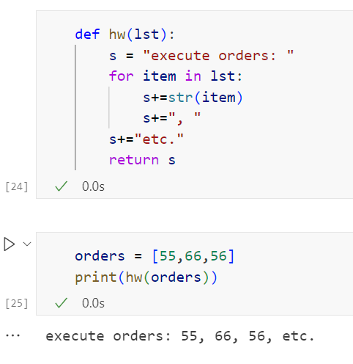
Functions
To let a function return a value, use the return statement

Slide 11
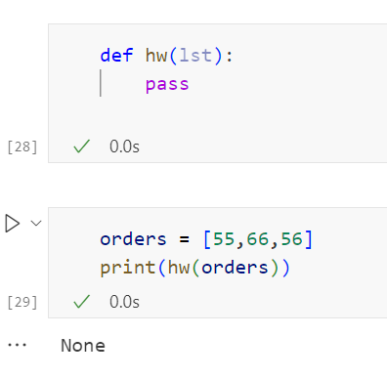
Functions
function definitions cannot be empty, but if you for some reason have a function definition with no content, put in the pass statement to avoid getting an error

Slide 12
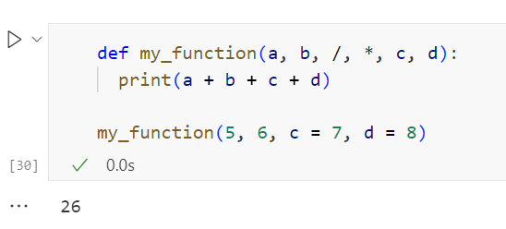
Functions
To specify that a function can have only keyword arguments, add *, before the arguments
To specify that a function can have only positional arguments, add , / after the arguments

Slide 13
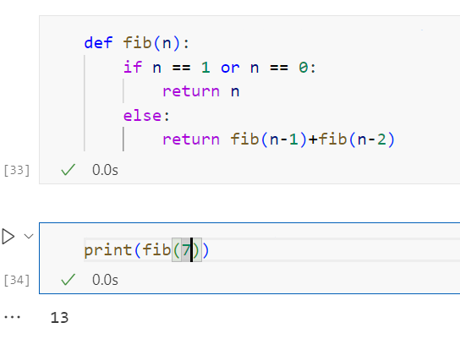
Functions
Python also accepts function recursion, which means a defined function can call itself

Slide 14
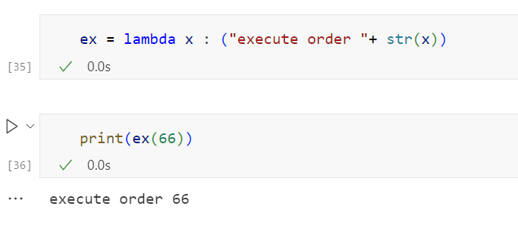
Lambda functions
A lambda function is a small anonymous function.
A lambda function can take any number of arguments, but can only have one expression.

Slide 15
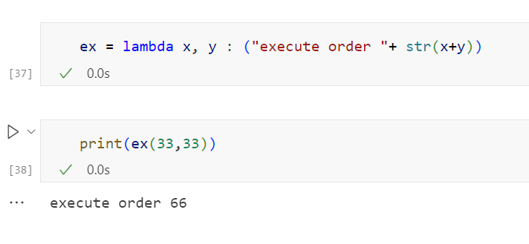
Lambda functions
Lambda functions can take any number of arguments

Slide 16
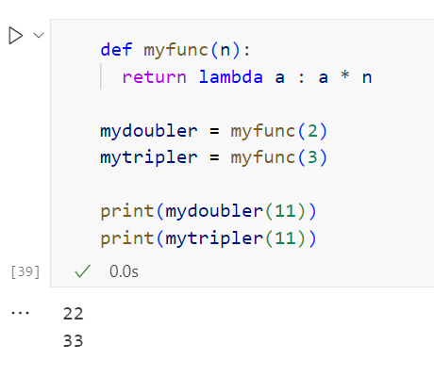
Lambda functions
The power of lambda is better shown when you use them as an anonymous function inside another function.
Say you have a function definition that takes one argument, and that argument will be multiplied with an unknown number

Slide 17
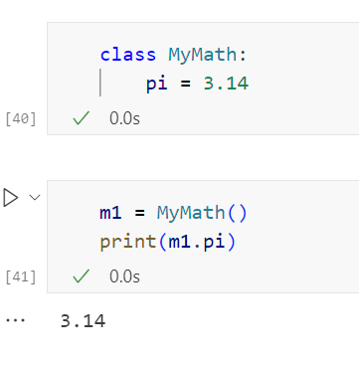
Classes and objects
To create a class, use the keyword class
An instance of a class is called an object

Slide 18
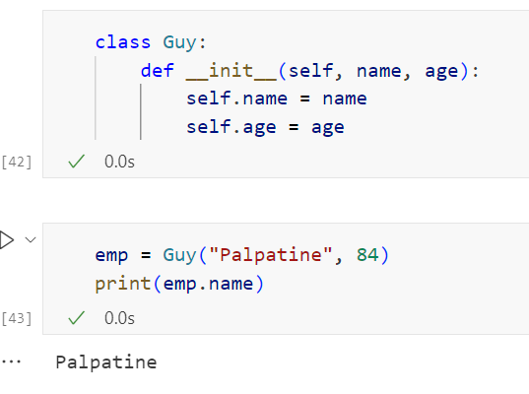
Classes and objects
The examples above are classes and objects in their simplest form, and are not really useful in real life applications.
To understand the meaning of classes we have to understand the built-in __init__() function.
All classes have a function called __init__(), which is always executed when the class is being initiated.
Use the __init__() function to assign values to object properties, or other operations that are necessary to do when the object is being created

Slide 19
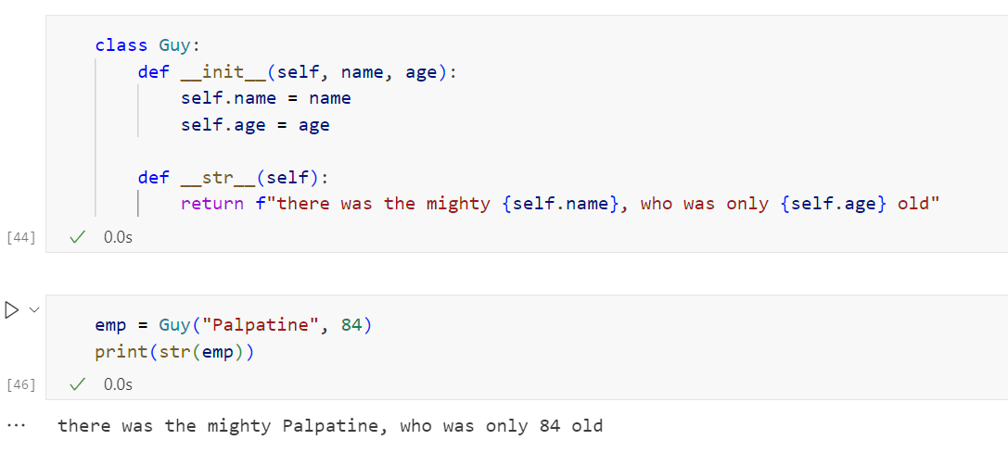
Classes and objects
The __str__() function controls what should be returned when the class object is represented as a string.
If the __str__() function is not set, the string representation of the object is returned

Slide 20
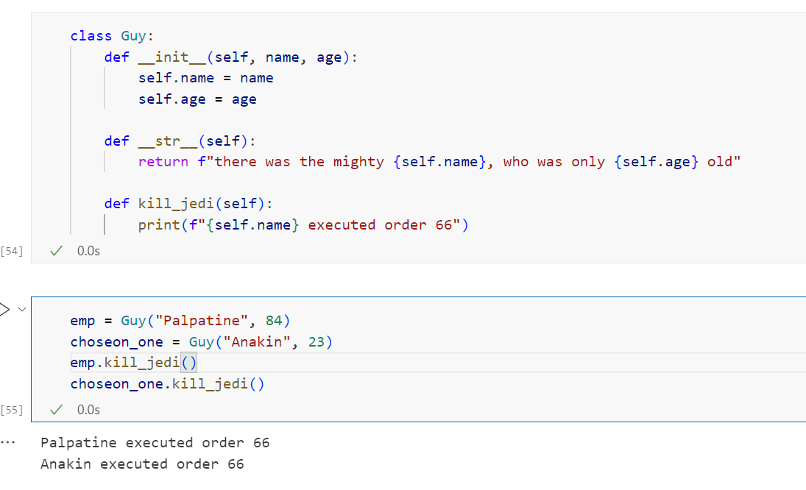
Classes and objects
Objects can also contain methods. Methods in objects are functions that belong to the object

Slide 21
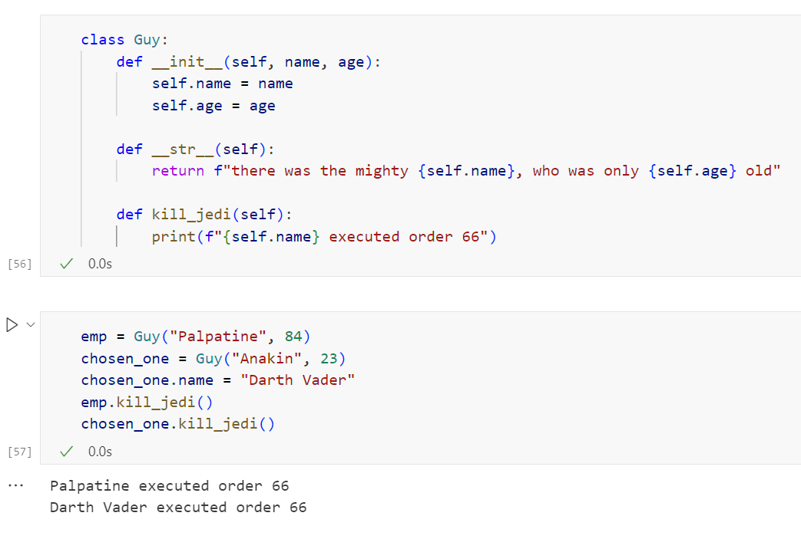
Classes and objects
You can modify properties on objects like this

Slide 22
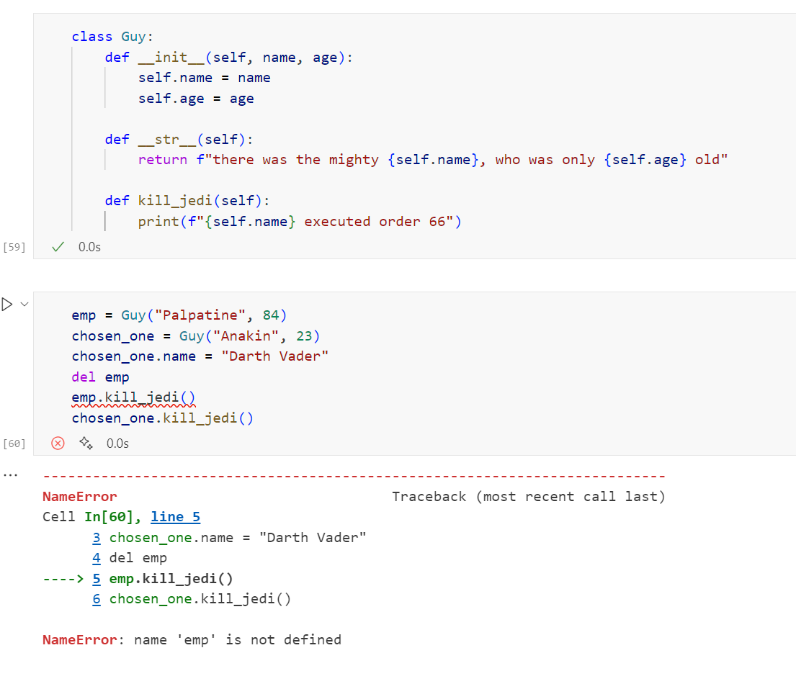
Classes and objects
You can delete properties on objects by using the del keyword
You can delete objects by using the del keyword

Slide 23
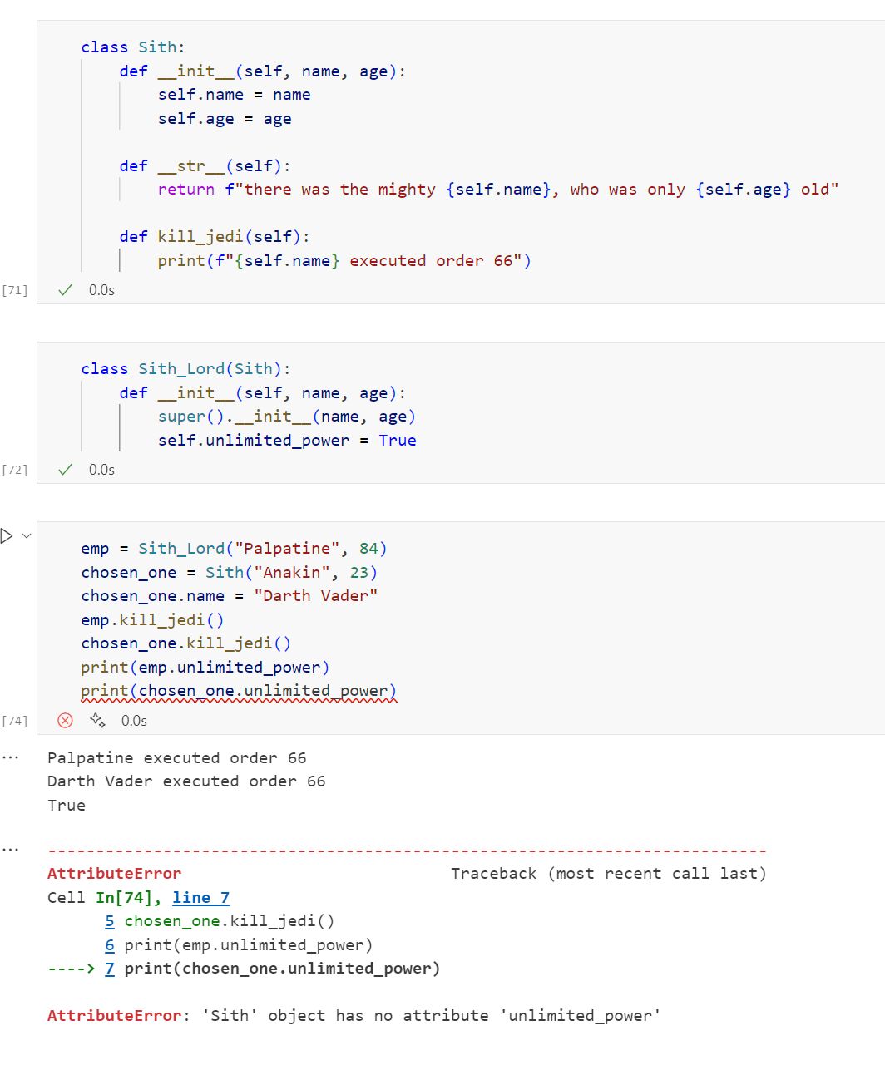
Inheritance
Inheritance allows us to define a class that inherits all the methods and properties from another class.
Parent class is the class being inherited from, also called base class.
Child class is the class that inherits from another class, also called derived class.

Slide 24
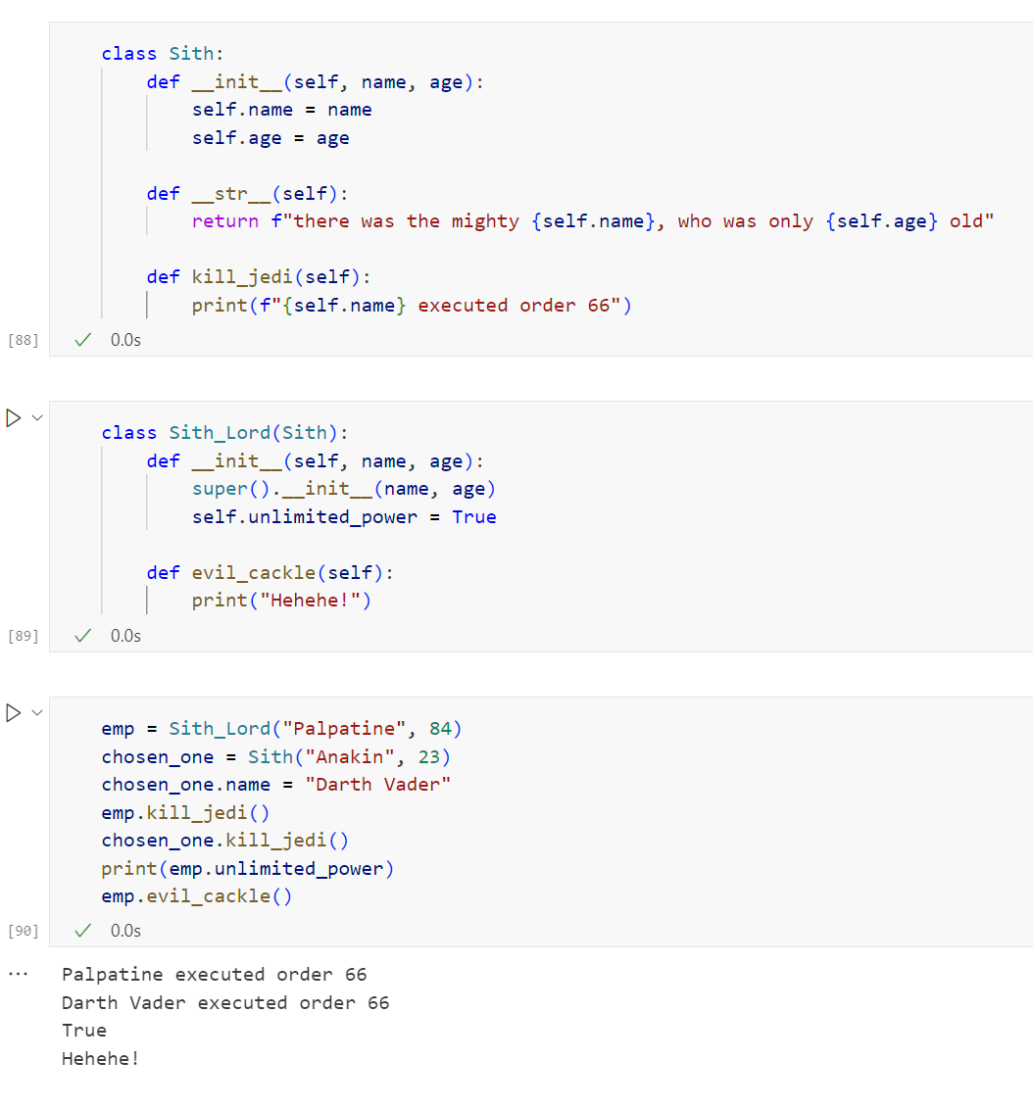
Inheritance
Inheritance allows us to define a class that inherits all the methods and properties from another class.
Parent class is the class being inherited from, also called base class.
Child class is the class that inherits from another class, also called derived class.

